Slide 1
Community Needs Assessment CVRPC Presentation
By Sue Minter, Executive Director
January 14, 2020
Notes:
This presentation will take the executive board through the process that has been used to get to the two options of the strategic plan they will look at and discuss
Themes from this process:
-Highly participatory with high engagement from all key stakeholders for Capstone
-Steeped in appreciative inquiry
-Validated the hard work and successes of Capstone, and in fact pushes Capstone to take a bigger leadership role in the three counties

Slide 2
Washington County
Central Office
20 Gable Place, Barre VT
Lamoille County
Lamoille County Integrated Service Center
250 Industrial Park Drive, Morrisville VT
Orange County
Randolph Office 12 Prince Street, Randolph, VT
Bradford Office 22 Whistle Stop Way, Bradford VT

Slide 3
Crisis Services
Food Shelf and Nutrition Support Including 3,981
Food shelf in Barre
3 Squares Application Assistance
Farm-to-Family Coupons
Home Heating and Utility Assistance Including 2,515
State Crisis Fuel Assistance Eligibility and Services
State Supplemental Fuel Application Assistance
Utility negotiations
Housing Counseling and Services Including 521
Rental Housing Counseling for participants who are literally homeless or on the verge

Slide 4
Family Supports
Head Start Including 386
Head Start – providing pregnant women and children with families birth to 5 years with high quality early care and education services
Family Literacy Center – held at Brook Street School in Barre, providing educational opportunities and social support for pregnant and parenting teens and young adults under the age of 26 seeking a high school diploma
Weatherization Including 535
Energy Efficiency Education – from the basics to more advanced topics, we empower homeowners, renters and the community to improve their own homes energy performance, saving money and resources
Weatherization and Energy Efficiency Services – save money and the planet. We offer comprehensive services for Vermonters of all incomes to ensure their home, apartment or housing unit is operating at its best.
Children’s Hour Supervised Visitation
Child Care Food Program

Slide 5
Economic Self-Sufficiency
Community Kitchen Academy/ Workforce Development 24
Intensive training program where participants can earn college credits and gain the skills they need for a culinary career.
Micro Business Development 37
From startup to long-term sustainability, we support new and established entrepreneurs to make their dreams and aspirations a reality.
Tax Preparation Program 1,624
Free tax preparation services for low-income Vermonters
Savings & Credit Programs 191
Assisting participants with credit coaching and saving for a brighter future.

Slide 6
2019 Community Needs Assessment
Socio-economic & demographic data
Engagement from 1,238 participants, partners, key stakeholders through a survey
Interviews, SOAR event, and strategic plan development
Notes:
Executive board already has seen summary of the community assessment, but the outcomes from this assessment fed into the design of the SOAR event and the interviews, so we are looking at the big picture findings from the assessment here to remind us what they were

Slide 7
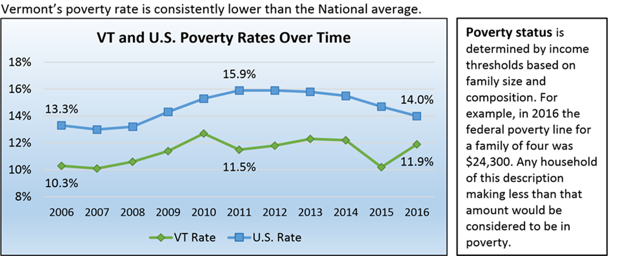
Community Needs Assessment – Overview
From 2006-2016, US Poverty rate stable, yet Vermont’s poverty rate increased by 2% over the decade.
Lamoille county rates for same time remained stable, but Orange and Washington Counties each increased by almost 2%.
Notes:
Key takeaways….there is still a huge need for support to break the cycle of poverty in the target counties
Data from 2006 to 2016
Inequality is increases even as the economy is in “recovery and growing”.

Slide 8
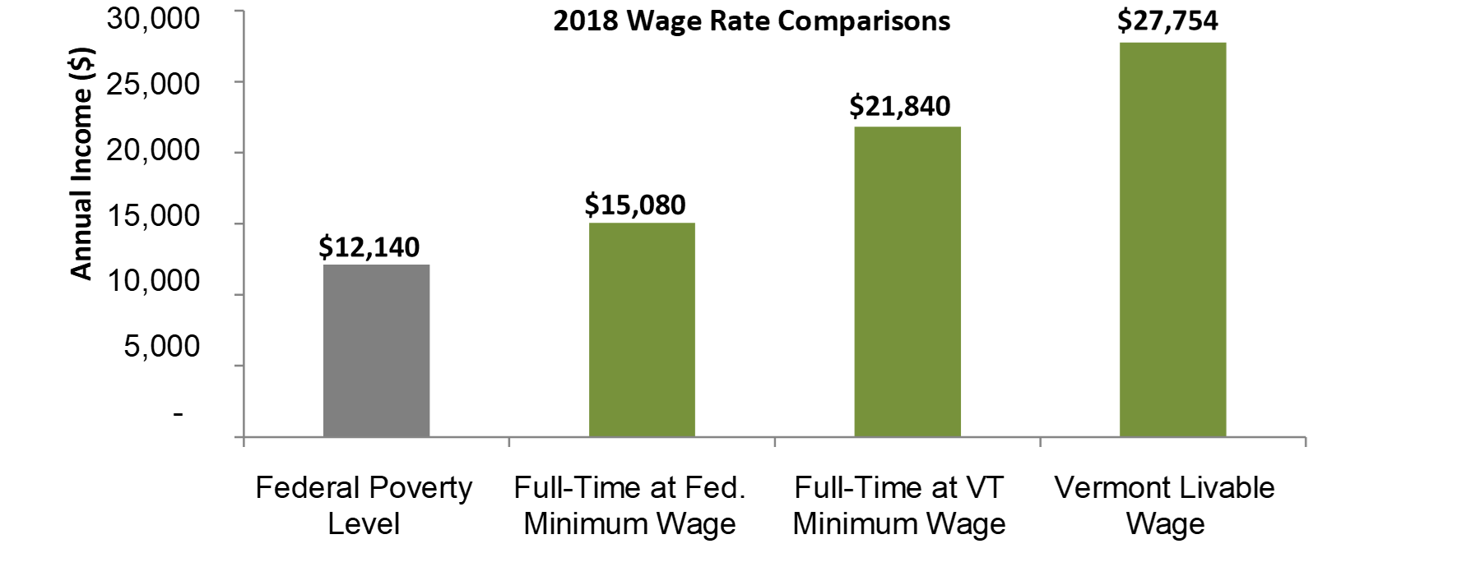
What’s a livable wage in Vermont?
The Vermont Livable Wage is defined in statute as the hourly wage required for a full-time worker to pay for one-half of the basic needs budget for a two-person household, with no children, and employer-sponsored health insurance, averaged for both urban and rural areas. The 2018 Vermont Livable Wage is $13.34 per hour
Notes:
The Vermont Livable Wage is defined in statute as the hourly wage required for a full-time worker to pay for one-half of the basic needs budget for a two-person household, with no children, and employer-sponsored health insurance, averaged for both urban and rural areas. The 2018 Vermont Livable Wage is $13.34 per hour
For a family of four, it’s $24K. Describe chart. This is still less than one income earner needs to live in VT.

Slide 9
2016 poverty estimates show a total of 12,052 persons living below 100% of the federal poverty level in the Capstone three-county service area.
Poverty
Report Area | Persons in Poverty 2000 | Poverty Rate 2000 | Persons in Poverty 2016 | Poverty Rate 2016 | Change in Poverty Rate 2000-2016
Report Location | 9,393 | 8.65% | 12,052 | 11.04% | 2.39%
Lamoille County | 2,291 | 9.8% | 2,986 | 12.1% | 2.3%
Orange County | 2,488 | 8.8% | 2,986 | 10.6% | 1.8%
Washington County | 4,614 | 8.1% | 6,080 | 10.8% | 2.7%
Vermont | 106,469 | 8.81% | 135,651 | 11.29% | 2.48%
United States | 31,581,086 | 11.3% | 44,268,996 | 14% | 2.7%
Notes:
Note data is from 2000 to 2016.

Slide 10
Community Needs Assessment - Overview
Child Poverty is high – 20.3% of children 0-4 are below federal poverty level
Low rate of education attainment - 37% of our service area has a High School Diploma or less.
Low-income females earn $10K to $12K less then males per year.
From 2000 to 2017, there was a 16% drop in home ownership rates in our service area.
High demand for housing – 0.9% residential vacancy rate.
In Orange County, 51% of renters pay 30% or more of their income for rent. A rate of 47% of those in Lamoille and Washington Counties are doing the same.
Notes:
Key takeaways….there is still a huge need for support to break the cycle of poverty in the target counties

Slide 11
Lamoille County – Most Acute Poverty
Lowest median income of the three counties
Highest poverty rate
Highest child poverty rate
Highest number of aging Vermonters in poverty
Highest rate of uninsured
Highest unemployment rate
28% of households in this county pay more than 50% of their income toward housing
0.0% residential vacancy rate
Lack of transportation prevents access to services in other counties

Slide 12
Capstone Community Needs Surveys
A total of 1238 People Responded to Capstone surveys:
655 Customers
363 Community Members
132 Partners
77 Staff
11 Board Members
Note that over 60% of respondents live in Washington County

Slide 13
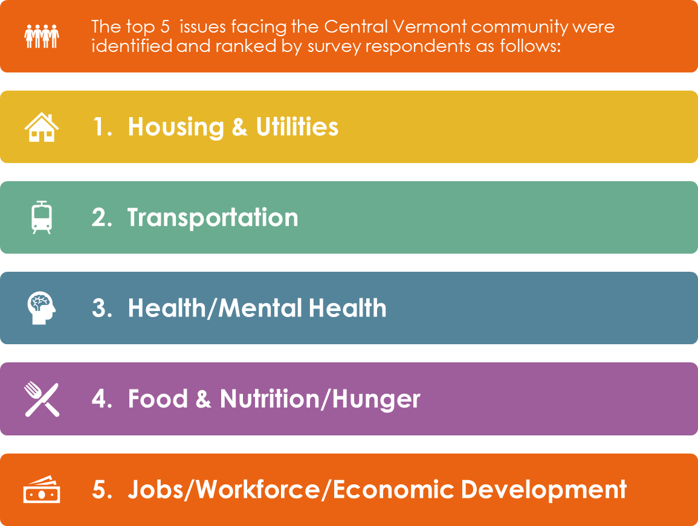
Customer, Community, Partner, Board and Staff Surveys: OVERALL PRIORITY AREAS

Slide 14
SOAR
Appreciative Inquiry approach to utilizing data from the community needs assessment.
Strengths, Opportunities, Aspirations and Results (SOAR) as an alternative to SWOT (Strengths, Weaknesses, Opportunities and Threats).
115 Discovery Interviews conducted.
SOAR event held June 20th at the Old Labor Hall, 125 participants: Customers, Partners, Board and Staff.
Notes:
Process included interviews with XX participants, staff, partners and community members around their high point working with Capstone before the event
This led to an all-day event that moved from individual event participants high points to prototyped potential programs
-High points led to discussions around opportunities, which informed discussions around aspirations for themed areas of intervention
The graphics in the following slides are a selection from all that were produced before the event and during….the “positive core” graphic is the high point, opportunities are opportunities and aspirations are captured in the “headlines” graphic
Look at the graphics and see if you can see themes coming through

Slide 15
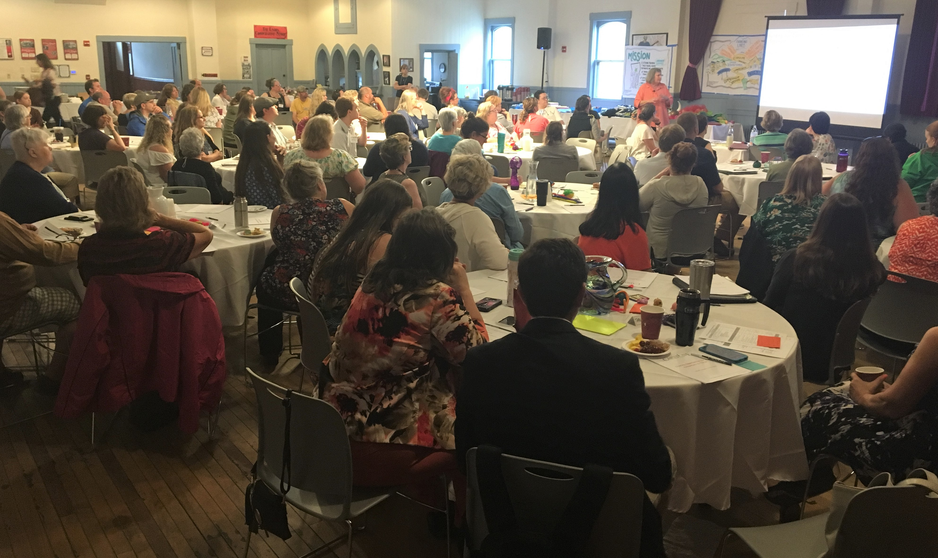

Slide 16
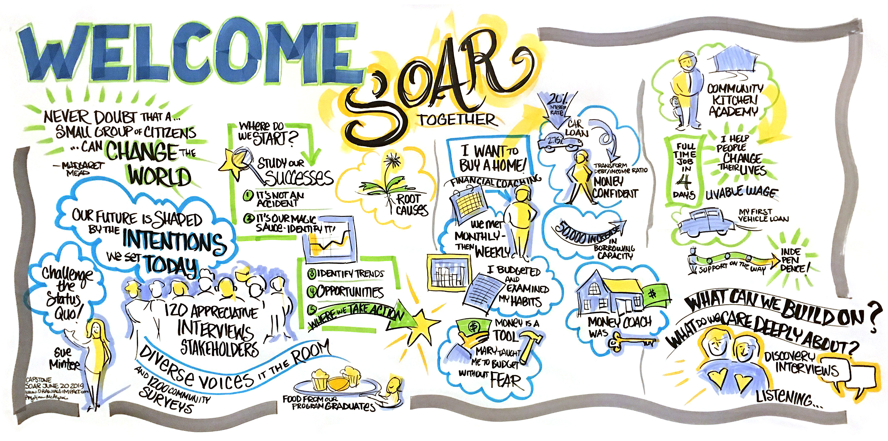

Slide 17
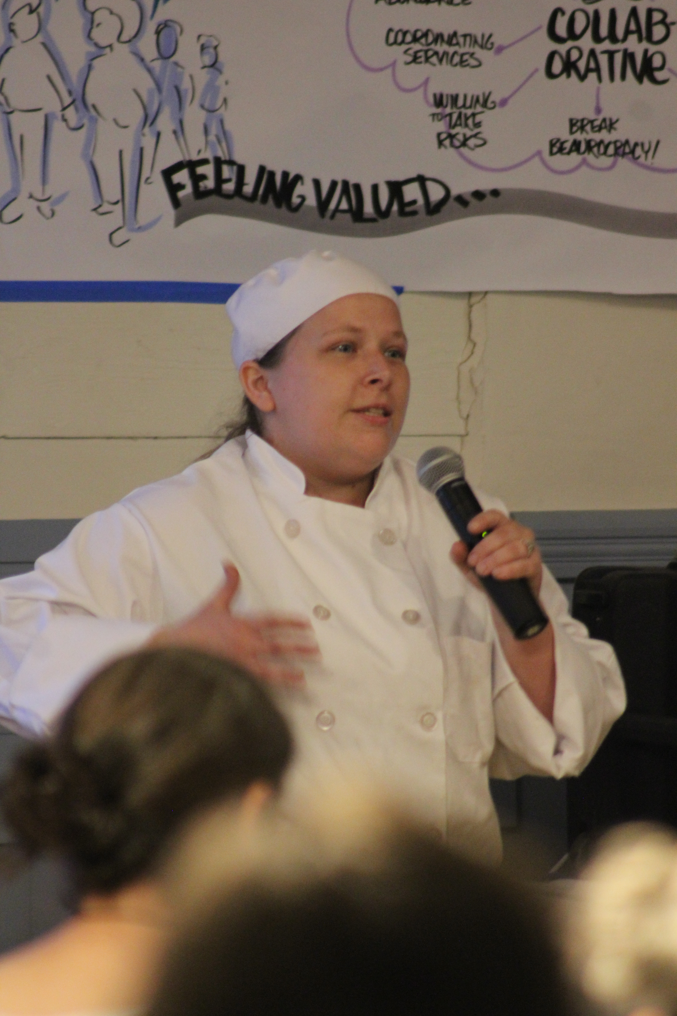
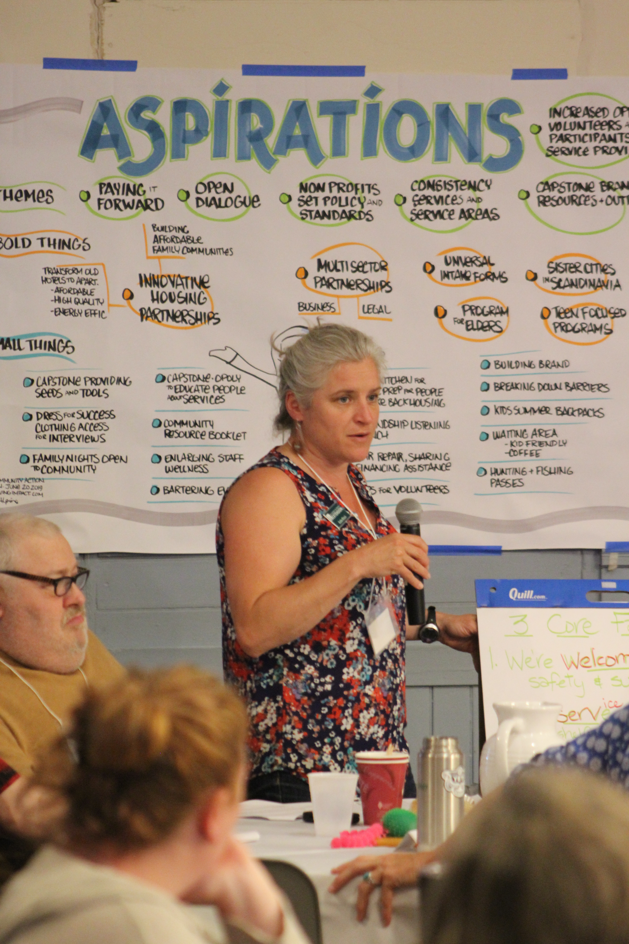

Slide 18
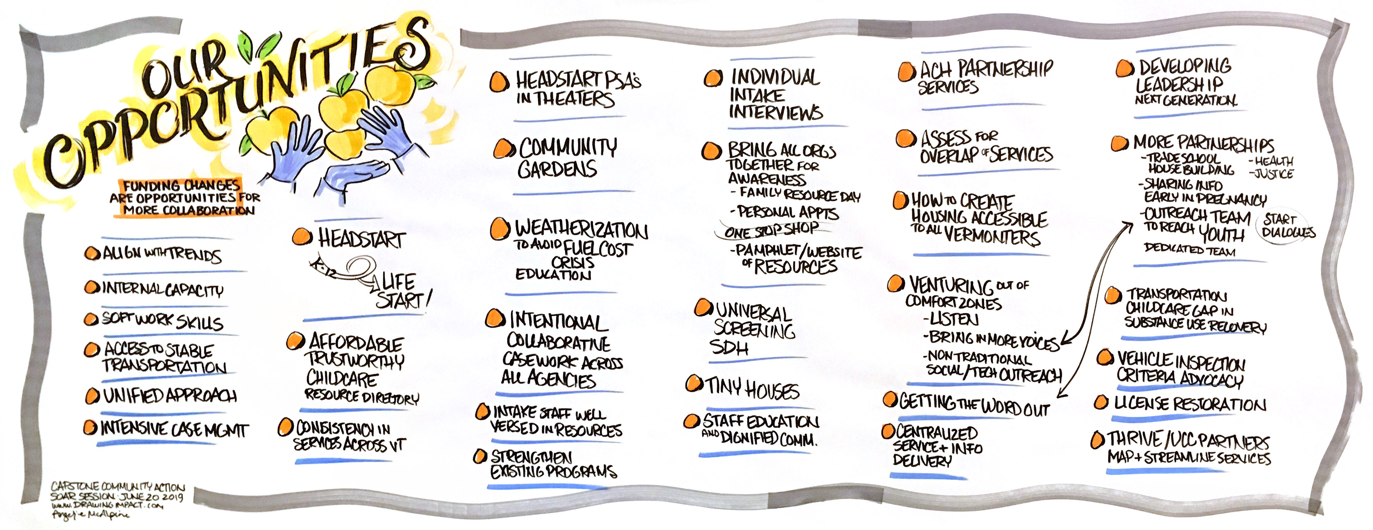
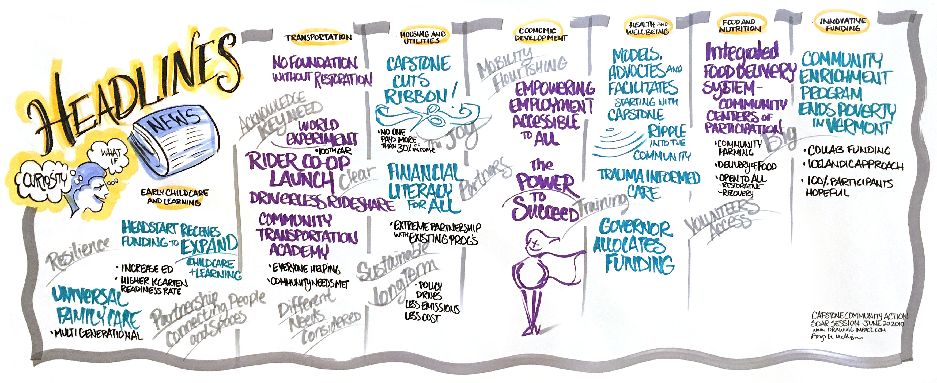

Slide 19
Output of SOAR Event: Themes
Dignity
Empowerment
Partnership & Collaboration
Holistic view of poverty
Equity & Justice
Notes:
We asked staff (leadership and management) what themes they saw in the graphics you just looked at and these 4 overwhelming came through…these four have become the driving force of the strategic plan

Slide 20
Strategic Direction & Investments
Transportation
Re-initiate and expand transportation
Lamoille County
Increase resources and expand impact within county
Communications & Volunteer Mobilization
Enhance communication and develop strategies and activation for volunteers.
Internships
Develop a program for next generation leaders at Capstone Community Action
Census 2020
Amplify local efforts

Slide 21
Let’s SOAR
Together!

Slide 22
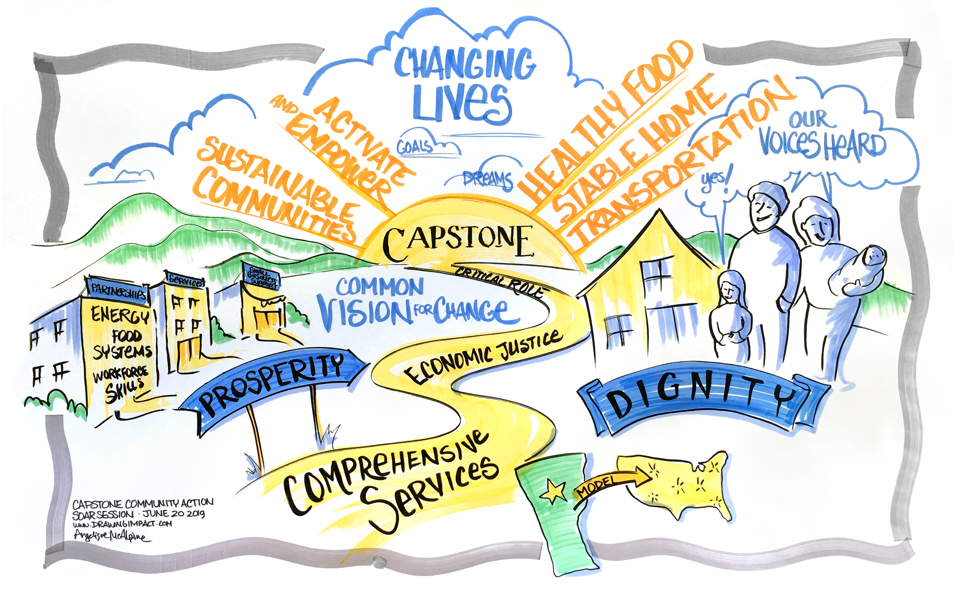
Sue Minter
Executive Director
Capstone Community Action
20 Gable Place, Barre, VT 05641
(802) 479 -1053
www.capstonevt.org
Find us on Facebook, Twitter and Instagram

