Slide 1
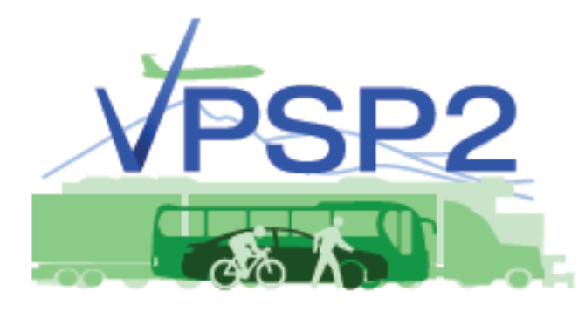
Vermont Transportation Project Selection and Project Prioritization
The way it was
The way it is now
Where we are heading – VPSP2 Overview
Central Vermont Regional Planning Commission Transportation Advisory Committee
November 24, 2020

Slide 2
Before there was Prioritization
The Project Delivery funnel was overflowing!
Inconsistency in the way new projects were selected
Unreliable project delivery times.
Capital Program
Notes:
In the mid 2000’s, we had more projects than we could deliver, resulting in many unkept promises. Each year, we were constantly delaying projects and as you can imagine, this impacted the credibility of the process.
In 2006, legislation was adopted to establish a project prioritization system to determine which projects were worked on first. This was successful as it established rules and expectations to follow and it allowed us to focus on streamlining and improving our project delivery processes which have been instrumental in establishing an effective asset management program.
Our current process is now about 12 years old. There is an opportunity within the next 3 to 4 years to accept more community driven projects into the Capital Program. However, currently there is not a defined process for an RPC/Municipality to get a project on to the Capital Program.

Slide 3
?
BLACK BOX
PROJECTS IN
PROJECTS OUT

Slide 4
Current System- Highways
2007 - 2019
Pavement Programs |  | Bridge Programs |  | Roadway Program |  | Traffic and Safety Program
Regional Priority | 20 | Regional Priority | 15 | Regional Priority | 20 | Regional Priority | 20
Pavement Condition Index | 20 | Bridge Condition | 30 | Hwy Sufficiency Rating | 40 | Intersection Capacity (LOS) | 40
Benefit-Cost | 60 | Remaining Life | 10 | Cost per Vehicle Mile | 20 | Crash Rate | 20
 |  | Functionality | 5 | Project Momentum | 20 | Cost per Intersection Traffic Volume (AADT) | 20
 |  | Load Capacity and Use | 15 |  |  | Project Momentum | 10
 |  | Waterway Adequacy & Scour Susceptibility | 10
 |  | Project Momentum | 5
 |  | Asset-Benefit Cost | 10
Total | 100 |  | 100 |  | 100 |  | 110
Programs included identified in 19 V.S.A. § 10g(l)
Notes:
This slide represents a snapshot of a few of the key transportation programs that we currently prioritize, we also prioritize for bike/ped programs, park-n-rides, aviation, rail, transit, etc.
Each RPC is given 20 pts to prioritize and they each do it differently.

Slide 5
Current System – Grant Programs
2007 - 2019
Bike and Pedestrian Facilities
Transportation Alternatives Program
Better Roads
Municipal Mitigation Grants
Town Highway Structures
Class 2 Town Highways
TH Federal Disasters
TH Non-Fed Disasters

Slide 6
Vision
Develop a performance-based, data driven project selection & prioritization framework that maximizes the “transportation value” delivered to Vermont taxpayers.
Notes:
Read the slide

Slide 7
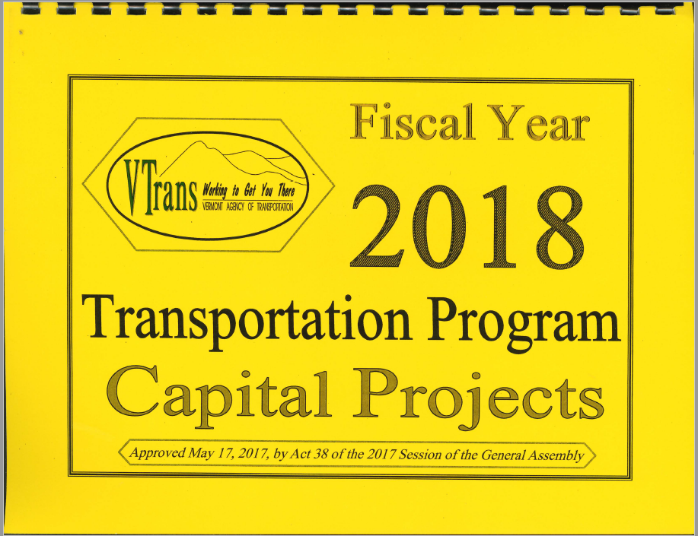
VPSP2 Goals
Asset Management
Modernization & Expansion
Identify and define how regional ideas for transportation improvements can become transportation projects.
Develop a fair, consistent, reliable, and standardized project selection and prioritization framework for use by all RPCs.
Revise current processes to increase transparency, provide “best value” while communicating the “transportation” value to our customers.
Develop processes and tools that guide the Agency towards holistic corridor management and planning.
Identify a process that allows VTrans to remove candidate projects without legislative approval.
Incorporate health and resiliency into VTrans’ project prioritization processes.

Slide 8
Customer Engagement
Held four Stakeholder Workshops to assess current process and develop evaluation criteria.
Cross Section of Workshop Participants
Regional Planning Commissions (RPCs)
Sister Agencies: VDH, ANR, ACCD, VEM
Special Interests: VLCT, VCIL, AARP, AAA,
Modal Interests: Rail Councils, Rail Operators, Bike / Ped Interest Groups, Transit Providers, VT Truck and Bus Association
VTrans
Notes:
The workshops were attended by a diverse group of stakeholders representing the five modes. These 8 criteria resonated with the attendees and were also recognized as key components of VTrans’ current strategic plan and are also themes that have been independently verified, through public and internal outreach, during the early stages of the long range transportation plan development. Stakeholders helped to determine the initial weighting of the evaluation criteria.

Slide 9
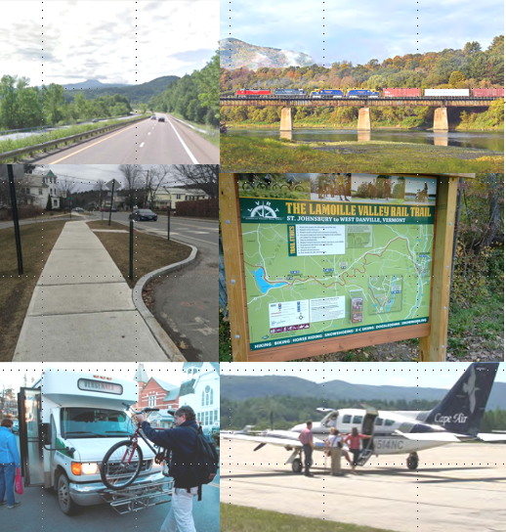
FIVE MODES
VPSP2 CRITERIA
HIGHWAY
RAIL
SAFETY
Max points = 20
ASSET CONDITION
Max points = 20
MOBILITY / CONNECTIVITY
Max points = 15
COMMUNITY
Max points = 10
WALKS, TRAILS & PATHS
ECONOMIC ACCESS
Max points = 10
ENVIRONMENT
Max points = 10
RESILIENCY
Max points = 10
HEALTH ACCESS
Max points = 5
TRANSIT
AVIATION

Slide 10
VPSP2 - 8 Evaluation Criteria
Safety: reducing the risk of crashes of any type and user.
Roadway and Intersection crashes, curve reduction factors
Asset Condition: maintaining multimodal infrastructure to preserve its current condition, by rehabilitating it to improve the condition and extend service life, and/or replacing it to improve its condition and service.
Customer service level, new asset/capacity, optimal treatment time
Mobility & Connectivity: increasing the reliable connectivity to jobs and other destinations and/or increasing the number of mode choices available for people and goods.
Connectivity to bicyclists, pedestrians, public transit and multi-modal facilities
Notes:
These 8 criteria resonate as key components of VTrans’ current strategic plan and are also themes that have been independently verified, through public and internal outreach, during the early stages of the long range transportation plan development.

Slide 11
VPSP2 - 8 Evaluation Criteria
Economic Access: increasing the ability of a region to attract and retain businesses and the workforce by providing better access to jobs.
Project Impact Map depicts the number of employed individuals potentially impacted by upcoming projects within ½, 1, and 2 mile vicinities.
Resiliency: minimizing the impacts of planned and unplanned events (e.g., work zones, floods and extreme weather).
Uses the Transportation Resilience Planning Tool (TRPT) to determine a project’s resilience score (combo of vulnerability and criticality scores)
Community: conforming to the goals and objectives defined in local and regional plans, and supporting the outcomes of a robust public process.
Identified in any local or regional planning document, town/Selectboard support, impacts to surround community facilities (schools, library, town offices, churches)
Notes:
These 8 criteria resonate as key components of VTrans’ current strategic plan and are also themes that have been independently verified, through public and internal outreach, during the early stages of the long range transportation plan development.

Slide 12
VPSP2 - 8 Evaluation Criteria
Environment: reducing the negative impacts of travel (e.g., reducing greenhouse gas [GHG] emissions, improving air quality, enhancing safe wildlife passage, and/or improving water quality).
Impacts to wildlife, air quality, water quality, cultural resources (look at required vs. voluntary mitigation in project scope).
Health Access: increasing the opportunity for physical activity and increases access to destinations that improve health (i.e., healthcare, education, and healthy food).
Access to health care/physical activity facilities (senior centers, parks, community gyms), healthy food destinations (grocery store, food shelf, school lunch programs), improved opportunity for physical activity (connect to existing sidewalk networks or links to facilities)
Notes:
These 8 criteria resonate as key components of VTrans’ current strategic plan and are also themes that have been independently verified, through public and internal outreach, during the early stages of the long range transportation plan development.

Slide 13
How Projects Get on the Capital Program
Asset Driven – Remains the same
Safety Driven – Remains the same
Grant Opportunities – Remains the same
Regionally Identified -- New
Harmonization – New, formalized
Notes:
Asset Driven: projects that are developed to improve the condition of transportation assets through preservation, rehabilitation or replacement strategies.
Safety Driven: Infrastructure projects that are needed to improve safety, reduce crashes, and reduce fatalities and serious injuries.
Grants Opportunities: VTrans-sponsored competitive grant opportunities.
Regionally Identified: Transform local and regional needs into transportation projects through consistently applied evaluation processes.
Harmonization: Coordinating and combining asset management, safety and regional needs into a single project. For example, a corridor management plan may identify one or more needs – that on its own, may not warrant adding it to the capital program – to get added to a programmed project.

Slide 14
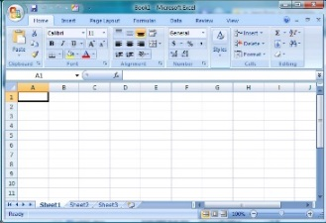
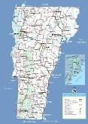
Ideas → Needs → Projects
NEEDS
PROJECTS
Scoping
IDEAS
NEEDS
PROJECTS
GIS Mapped
PE, ROW, Const.
Asset Safety Resiliency Mobility Environment Economic Community Health
Condition Connectivity Access Access
VPSP2 Framework
Notes:
Projects that follow the Community Driven Path often start as ideas that are not yet well defined.
At the projects stage….the concept is to identify the future modernization and expansion needs and the amount of budget available to address those needs and then SELECT the projects with the highest transportation value relative to cost.

Slide 15
Qualifications Worksheet
To address regionally identified ideas and needs, a Qualifications Worksheet was developed to assess the scope and evaluate it’s potential Transportation Value.
See Qualifications Worksheet

Slide 16
Harmonization
“incorporation of need(s) that would not have otherwise been included in the project.”
(e.g. a paving project is coming through and drainage culverts are in need of replacement. Like Howe Hill Rd in Pomfret-Sharon
Or when VT107 was getting resurfaced after T.S. Irene, the VT100/VT107 intersection was improved along with the creation of a park and ride).
Consideration to be included in project scope is key…how much scope creep, financial addition, ROW impacts, natural project inclusion needs to be balanced.

Slide 17
What to Expect for February 2021?
VTrans will send a list of projects derived from Asset and Safety Management system for TACs to review, evaluate and prioritize.
2021 will review only Paving, Roadway and Traffic & Safety projects. 2021 will review State and TH Bridge projects.
RPCs will work with TAC to generate a “Transportation Value” for each project.
TAC and CVRPC Board approve of list to submit to VTrans by Spring 2021.

Slide 18
Questions?

