Slide 1
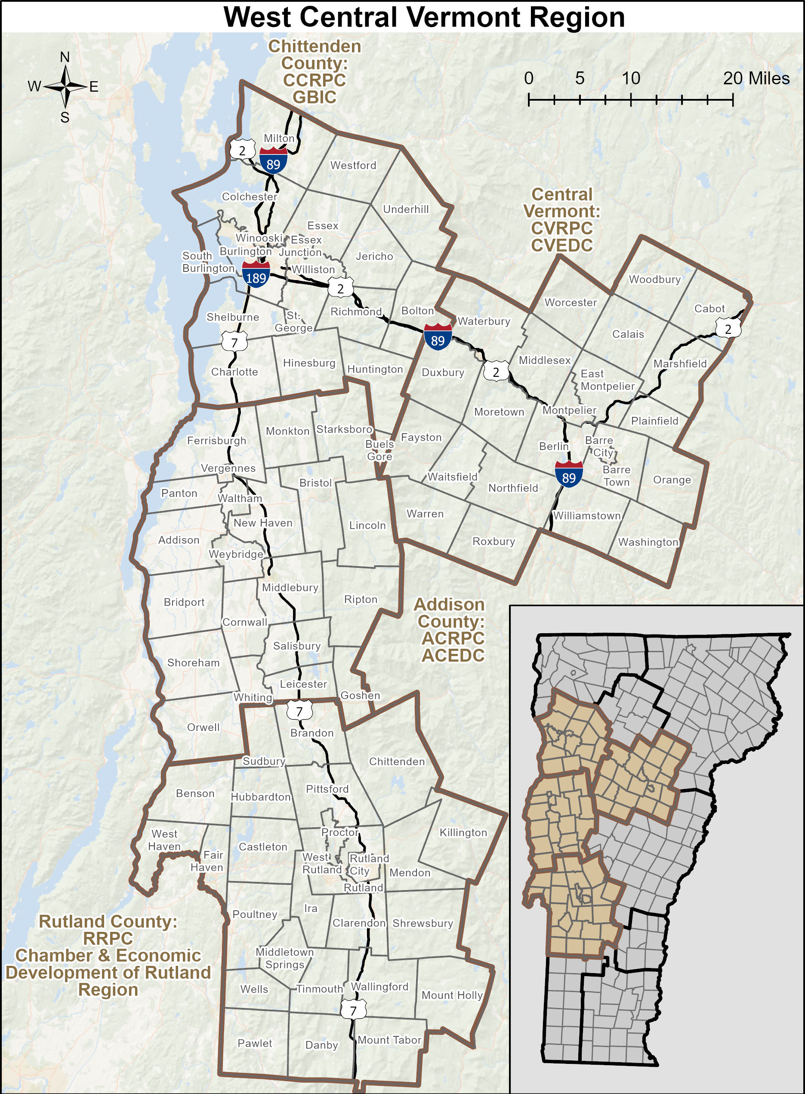
West Central Vermont
Comprehensive Economic Development Strategy (CEDS)
Becoming an
Economic Development District?

Slide 2
West Central Vermont CEDS
What is:
EDA: | U.S. Economic Development Administration
 | Mission: To lead the federal economic development agenda by promoting innovation and competitiveness, preparing American regions for growth and success in the worldwide economy.
CEDS: | Comprehensive Economic Development Strategy
 | A strategic blueprint for regional economic development. The result of a regionally-owned planning process designed to guide the economic prosperity and resiliency of an area or region. It provides a coordinating mechanism for individuals, organizations, local governments, and private industry to engage in a meaningful conversation and debate about the economic direction of their region. Between Oct 2021 and March 2023, the RPCs and RDCs of Chittenden, Addison, and Rutland Counties, and Central Vermont, implemented a public input-driven planning process funded by the EDA to develop the West Central VT CEDS. It was submitted to the US EDA in May and approved on June 6, 2023.

Slide 3
West Central Vermont CEDS
What is:
EDD: | Economic Development District
 | Economic Development Districts (EDDs) are multi-jurisdictional entities, commonly composed of multiple counties and, in certain cases, even cross-state borders. They collaborate and coordinate to implement a locally-based, regionally-driven economic development strategic blueprint (CEDS), making the region eligible for federal funding through the EDA.
Eligibility Requirements
 | Approved CEDS At least one geographical area within the designated service boundaries that meets EDA’s regional distress criteria. (Distressed census tracts are defined as having an unemployment rate that is 1 point greater than the national average, looking back over 24 months, or per capita income that is 80% or lower than the national average. The West Central CEDS Region has 13 DCTs.)

Slide 4
West Central Vermont CEDS
WHY BE AN EDD?
Provides a formal structure to continue regional economic development collaboration, planning, and establishing priorities for Federal investment
Members become eligible for competitive EDA funding for infrastructure, planning, and other economic and community development activities
Entire region eligible for EDA funding instead of only distressed census tracts
Potential for non-competitive, priority EDA funding awarded to EDDs only (e.g., disaster assistance)
Potential for additional economic development funding for planning, technical assistance to EDA applicants, and organizational capacity funding
Higher priority for other Federal funding for projects from within the EDD
Completes Vermont statewide development of CEDS and EDD designations

Slide 5
West Central Vermont CEDS
WHERE ARE WE IN THE PROCESS
January 2023 Create a CEDS
March 2023 CEDS Adoption by Regional Partner Boards
May 2023 Submit CEDS for EDA Approval
June 2023 Obtain CEDS Approval from EDA
July 2023 Create EDD Governing Body documents (Bylaws, MOU)
September/October 2023 EDD Structure Approval by Regional Partner Boards
October 2023 Apply to EDA
Unknown Obtain EDD Designation from EDA

