Slide 1
Winooski River Basin Water Quality Council Meeting
20 July 2023

Slide 2
Agenda
1:00 Call to order & Roll call
1:05 Updates to agenda
1:10 Public Comment
1:15 Review & approve minutes from June 15, 2023 meeting (action)
1:25 Project Ranking & Prioritization (action)
2:25 Election of Officers (action)
2:45 Announcements
3:00 Adjourn

Slide 3
Agenda
1:00 Call to order & Roll call
1:05 Updates to agenda
1:10 Public Comment
1:15 Review & approve minutes from June 15, 2023 meeting (action)
1:25 Project Ranking & Prioritization (action)
2:25 Election of Officers (action)
2:45 Announcements
3:00 Adjourn

Slide 4
Agenda
1:00 Call to order & Roll call
1:05 Updates to agenda
1:10 Public Comment
1:15 Review & approve minutes from June 15, 2023 meeting (action)
1:25 Project Ranking & Prioritization (action)
2:25 Election of Officers (action)
2:45 Announcements
3:00 Adjourn

Slide 5
Agenda
1:00 Call to order & Roll call
1:05 Updates to agenda
1:10 Public Comment
1:15 Review & approve minutes from June 15, 2023 meeting (action)
1:25 Project Ranking & Prioritization (action)
2:25 Election of Officers (action)
2:45 Announcements
3:00 Adjourn

Slide 6
Agenda
1:00 Call to order & Roll call
1:05 Updates to agenda
1:10 Public Comment
1:15 Review & approve minutes from June 15, 2023 meeting (action)
1:25 Project Ranking & Prioritization (action)
2:25 Election of Officers (action)
2:45 Announcements
3:00 Adjourn

Slide 7
Project Review: Mountain View Road Erosion Mitigation
Primary Contact: Dan Albrecht, Senior Planner, Chittenden County Regional Planning Commission
Project Type: Project Development
Project Phase: Identification / Assessment
Project Description: Procure engineering services to identify projects along a (private) road that will reduce erosion & phosphorous discharge. Result of effort will be a brief memo describing each proposed practice.
  Rock lining of road ditches
  Check dams in road ditches
  Outfall protection on downhill end of cross-culverts
P-reduction: unknown / not required for Project Development
Project Budget: $4,431

Slide 8
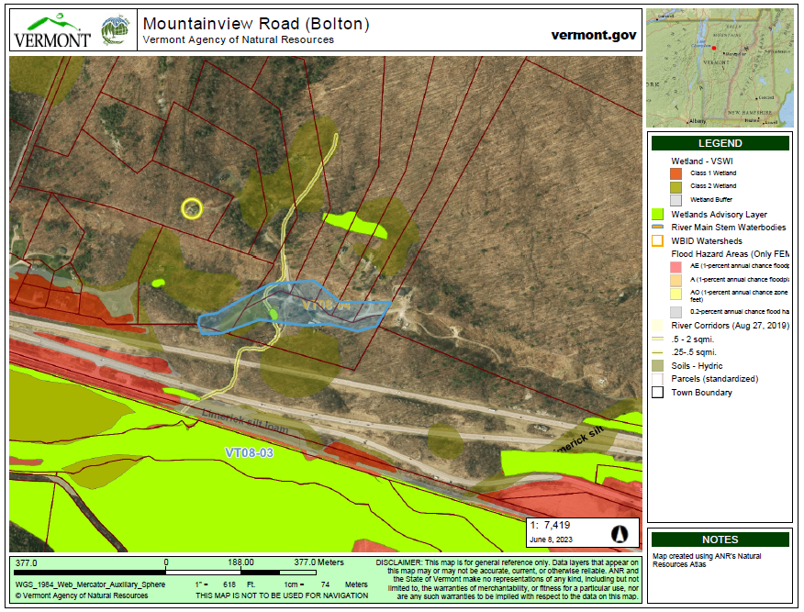
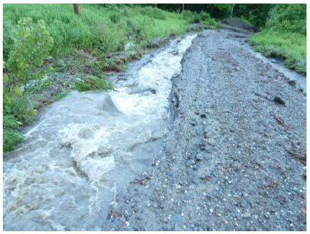
Project Review: Mountain View Road Erosion Mitigation

Slide 9
Project Review: John Fowler Road – Winooski Berm Removal
Primary Contact: Allaire Diamond, Ecologist, Vermont Land Trust
Project Type: Floodplain / Stream Restoration – Preliminary Engineering Design
Project Phase: Preliminary Design
Project Description: Procure engineering services to design berm removal along the Winooski River. Project builds off previous work completed by the Vermont Fish & Wildlife Department.
P-reduction: 118.95 kg / yr
Project Budget: $44,604

Slide 10
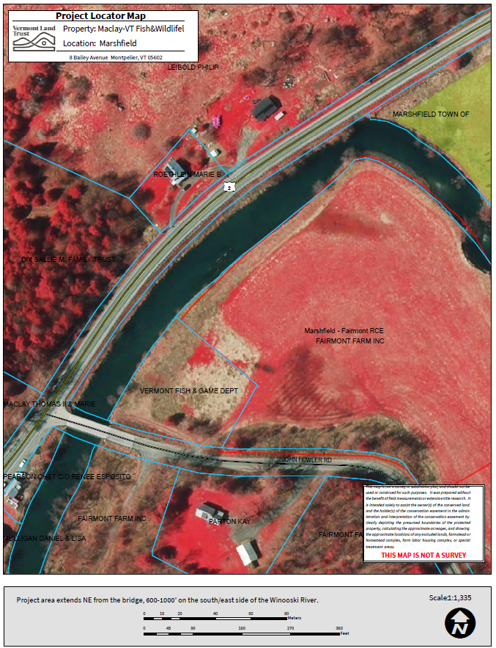
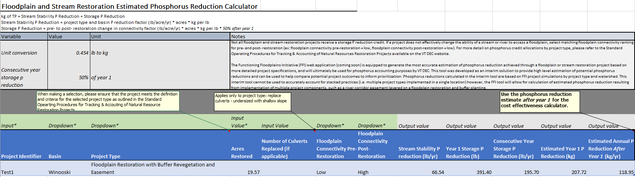
Project Review: John Fowler Road – Winooski Berm Removal

Slide 11
Agenda
1:00 Call to order & Roll call
1:05 Updates to agenda
1:10 Public Comment
1:15 Review & approve minutes from June 15, 2023 meeting (action)
1:25 Project Ranking & Prioritization (action)
2:25 Election of Officers (action)
2:45 Announcements
3:00 Adjourn

Slide 12
Election of Officers
ARTICLE V ORGANIZATION
Section 501 Officers: The officers of the BWQC shall include a Chair and Vice Chair.
ARTICLE VI ELECTIONS
Section 601 Nominations: Nominations will be taken from the floor at the Annual Meeting.
Section 602 Election of Officers: Officers shall be elected by a majority vote of the BWQC at its Annual Meeting.
Section 603 Terms of Office: The terms of office for the Chair and the Vice Chair shall be 1 year beginning at the Annual Meeting. Officers shall hold office until their successors have been elected and installed. BWQC members may serve as officers for a maximum of three consecutive terms.

Slide 13
Election of Officers
ARTICLE VII DUTIES
Section 702 Chair: The Chair of the BWQC shall guide the planning and facilitation of BWQC meetings in coordination with the CWSP. The Chair may perform other duties customary to the office. Unless the Chair chooses to abstain or recuse themselves, they shall cast a vote on all issues voted on by the BWQC. Whenever possible, the Chair will pursue decision making by consensus.
Section 703 Vice Chair: The Vice Chair shall act as Chair in the absence of the Chair.
ARTICLE VIII MEETINGS
Section 803 Annual Meeting: The Annual Meeting shall be the first regularly scheduled meeting of the CWSP’s fiscal year.

Slide 14
Agenda
1:00 Call to order & Roll call
1:05 Updates to agenda
1:10 Public Comment
1:15 Review & approve minutes from June 15, 2023 meeting (action)
1:25 Project Ranking & Prioritization (action)
2:25 Election of Officers (action)
2:45 Announcements
3:00 Adjourn

Slide 15
Agenda
1:00 Call to order & Roll call
1:05 Updates to agenda
1:10 Public Comment
1:15 Review & approve minutes from June 15, 2023 meeting (action)
1:25 Project Ranking & Prioritization (action)
2:25 Election of Officers (action)
2:45 Announcements
3:00 Adjourn

