Slide 1





MRV Active Transportation Corridor Presentation to CVRPC January13, 2026

Slide 2
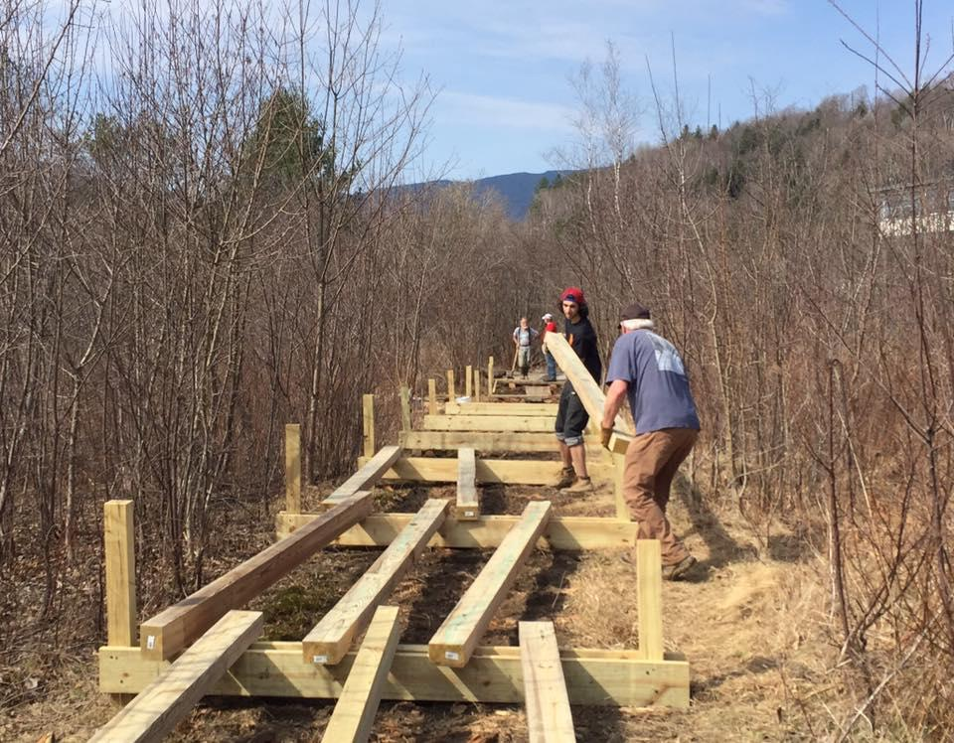
For over thirty years Mad River Path board and volunteers held a vision for connecting Warren and Moretown (and later Middlesex) with an unbroken bike and pedestrian path
Notes:
For over thirty years Mad River Path board and volunteers held a vision for connecting Warren and Waitsfield with an unbroken bike and pedestrian path.

Slide 3
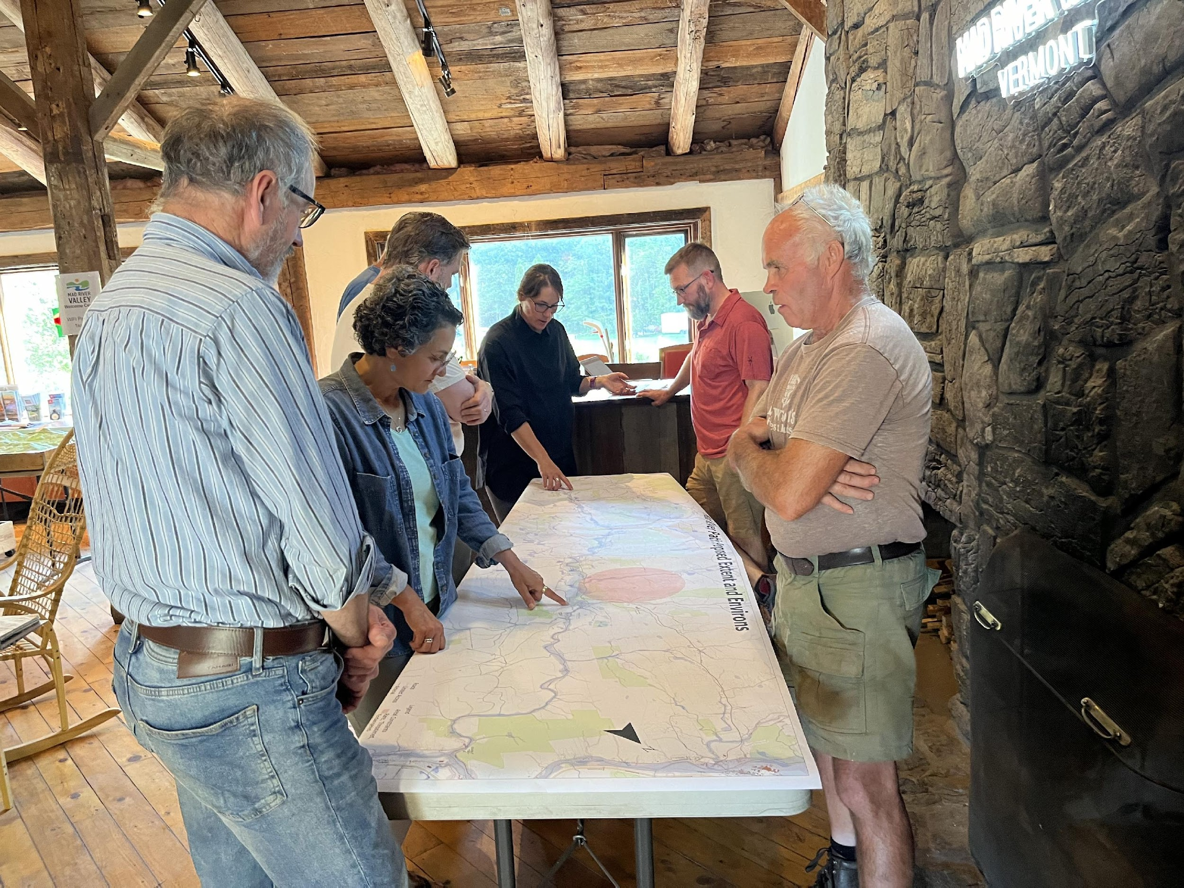
In the summer of 2024, with support from CVRPC, MRVPD, and five valley towns, along with an $ 84,000 Transportation Alternatives Grant, we embarked on an Active Transportation Corridor Scoping Study.
Notes:
We now have a unique opportunity to realize this vision for the benefit of present and future generations

Slide 4
Major Findings
Three alternatives were evaluated: Alternative A would improve existing trails only, Alternative B would add widened bike lanes along Route 100/100B, and Alternative C would build a 10-foot separated path from traffic.
The study demonstrated strong community support for Alternative C, with over 300 residents participating across three public meetings, resulting in 218 out of 280 votes (78%) supporting a fully separated shared-use path.

Slide 5
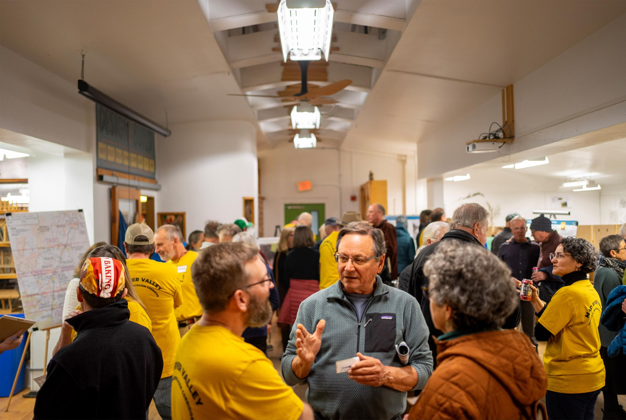
November 18, 2024
The study identified the preferred alternative to be a hybrid approach that prioritizes safety by combining new construction of a 10-foot wide, aggregate shared-use path, with improved existing trails where feasible. This approach would provide safe active transportation access for all ages and abilities, linking villages to schools, businesses, and recreation areas, serving as a major tourism and economic development driver, and creating Vermont's premier multimodal corridor.
Notes:
Through public engagement, field work, and engineering study, we have determined the best way to connect the villages in the Mad River Valley with a contiguous off-road Bike and Pedestrian Path.

Slide 6
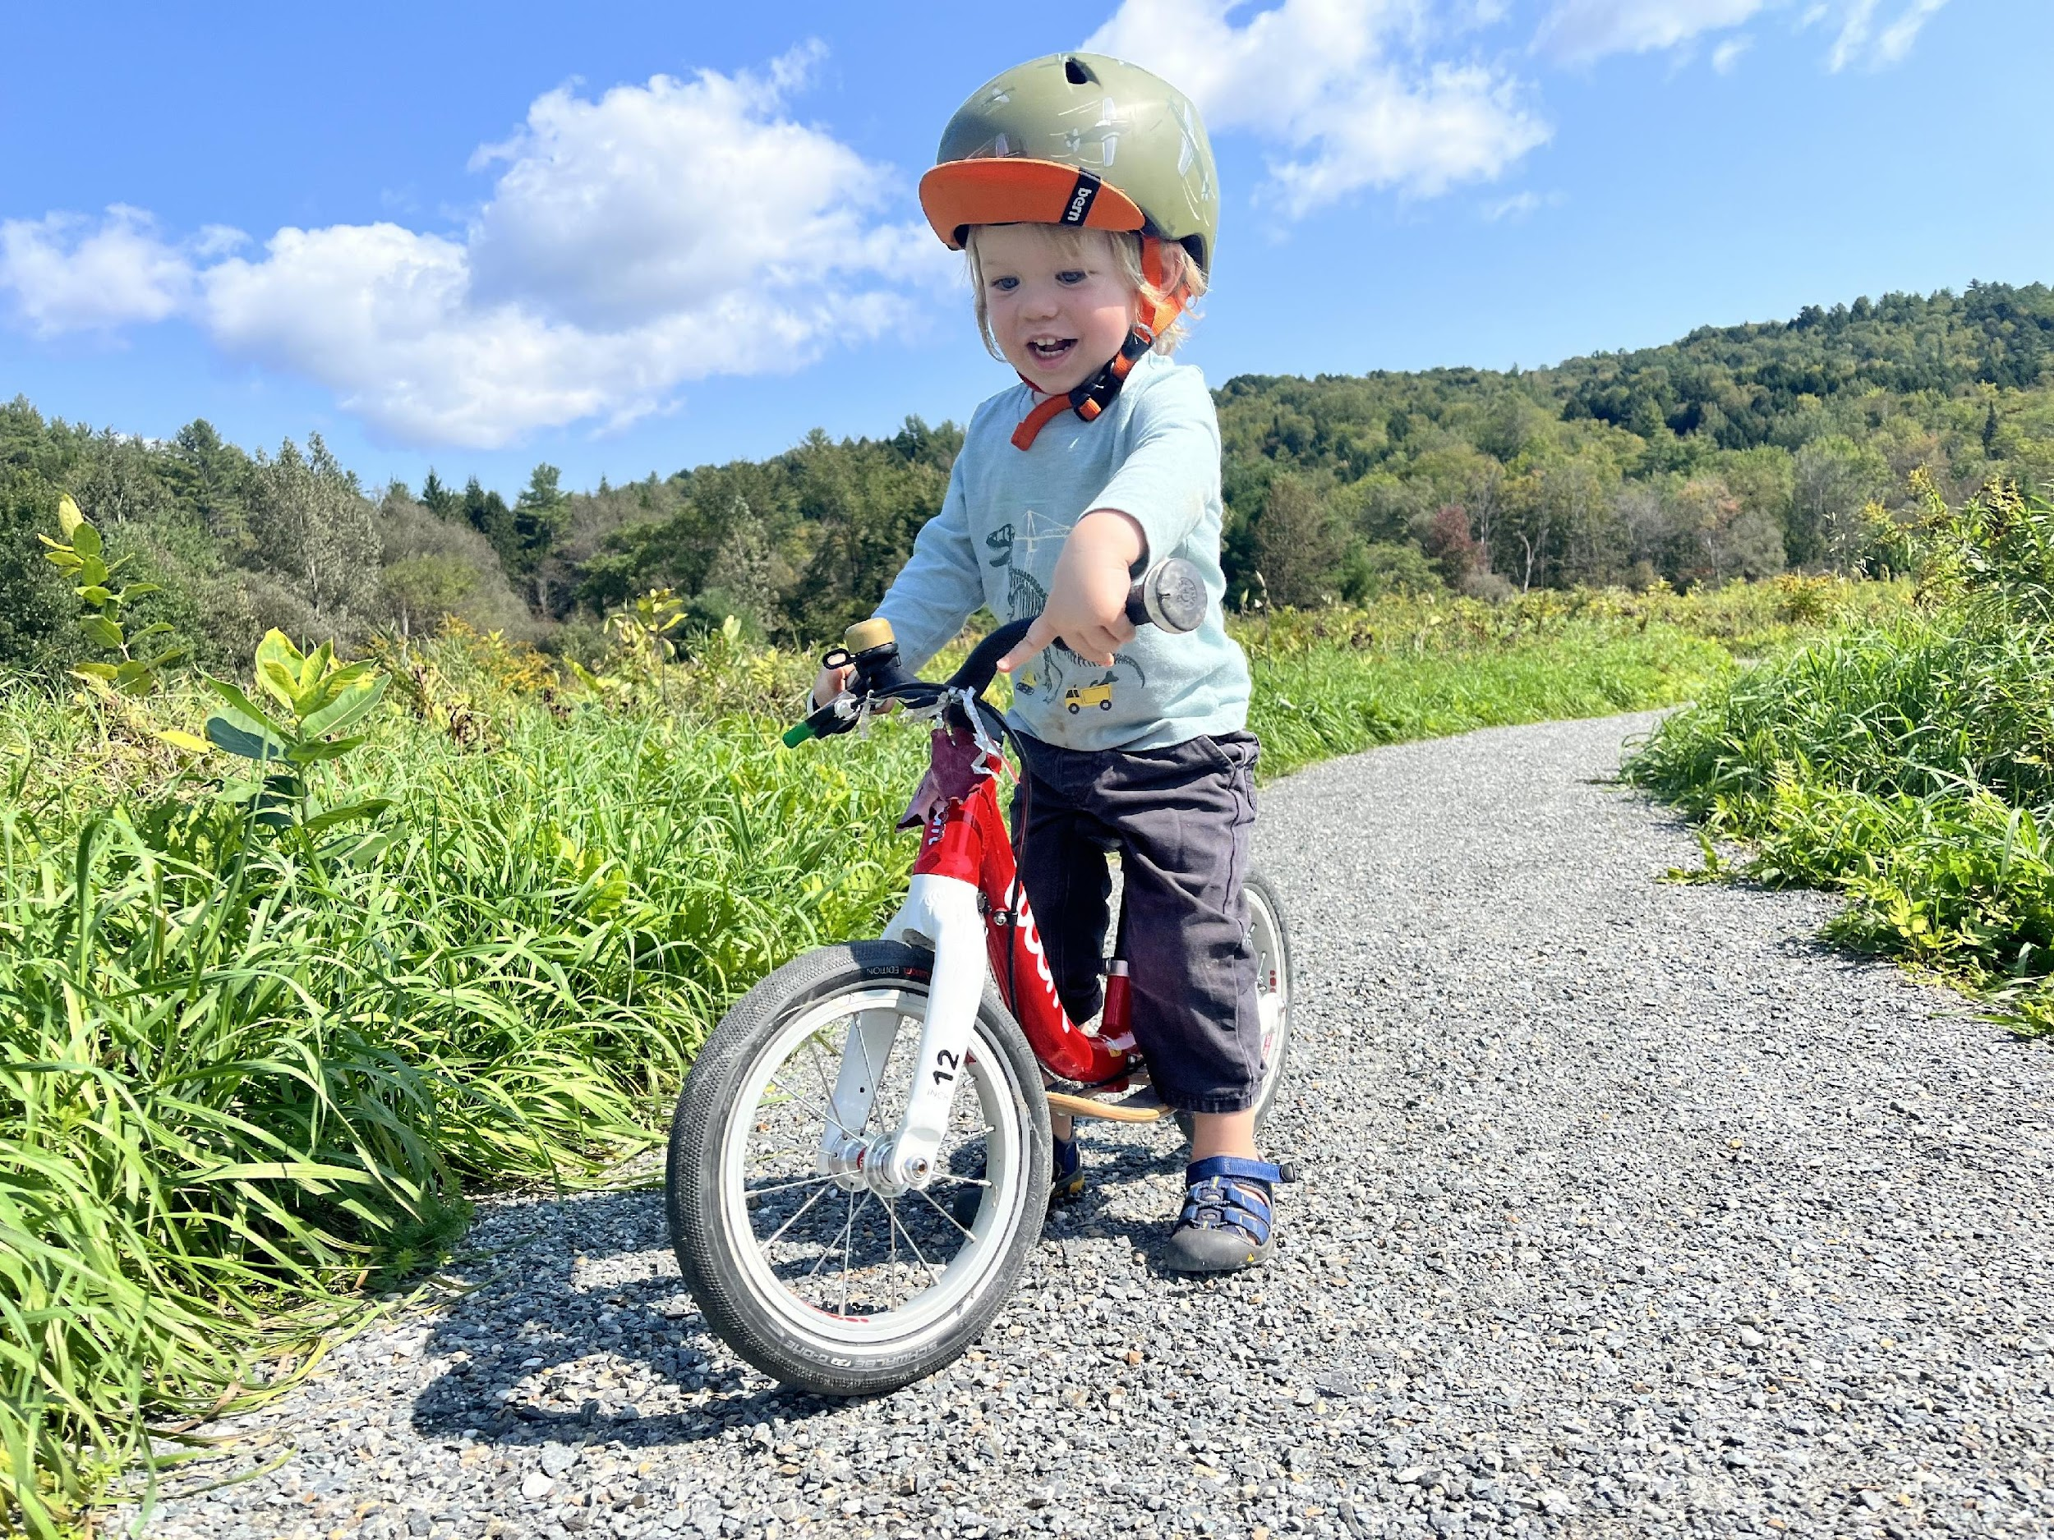
Completing the Mad River Path is a long-term commitment that requires a sustained effort by the entire valley with support from the state. Together, we will manifest a Path that connects communities, provides access to nature for everyone, improves well-being, reduces carbon emissions, and becomes a driver for the sustainable recreational economy.
Notes:
We now have a unique opportunity to realize this vision for the benefit of present and future generations

Slide 7
Phasing
Phasing prioritizes segments that close the gaps between the existing sections of the Mad River Path. These are the “low-hanging fruit” opportunities, where the construction of a relatively short segment of the off-road path creates several miles of connectivity.

Slide 8
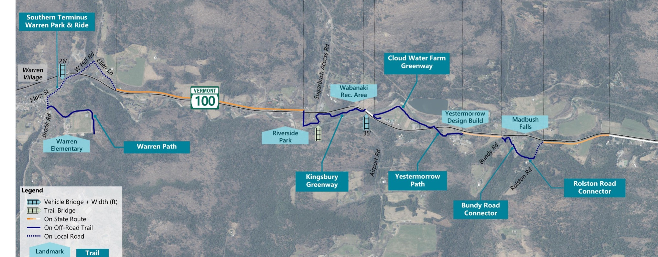
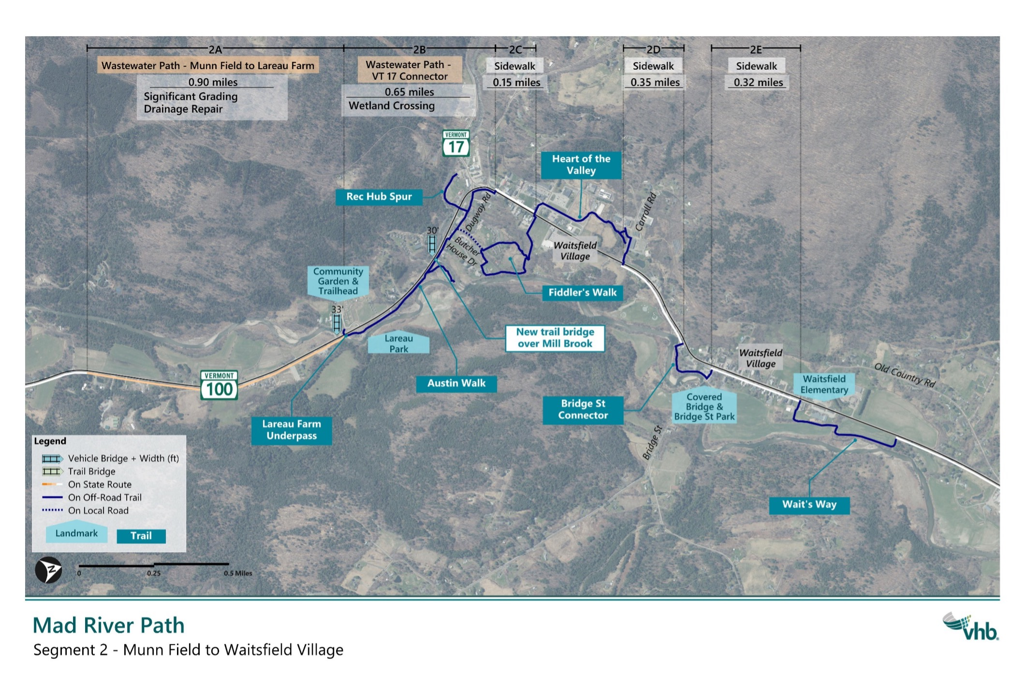
Phases I-II Warren - Waitsfield
Warren Path, 1.1 mile
½ mile needed connection
Waitsfield Path, .9 mile

Slide 9
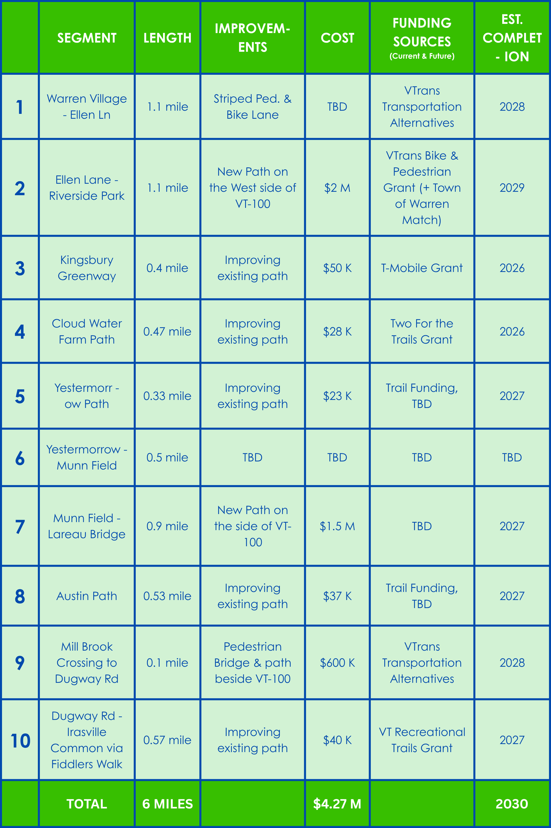
Submitted application with CVRPC
Working with LocalMotion, VHB, and
Warren
Applied for Bike/Ped Grant with Warren committing $400K. Did not get the grant, but received a specific guidance on how to improve the 2026 application
T-Mobile Grant Submitted (did not receive)
Ben and Jerry Grant received. Scheduled for construction for summer 2026
Two For the Trails Grant Submitted 9/25
(Did not get the grant 1/25)
Improve through community fundraising in 2027
Secured a path easement through a key private property. Negotiating with a landowner for an easement to Kingsbury Rd
In discussion with a key landowner
2027 round of RTP funding
Submitted TA Grant,
Working with VHB, and Waitsfield.
Town committed $60K, and will bring a second $60K request to the voters
Preparing 2026 RTP Grant based on feedback received in 2025

Slide 10
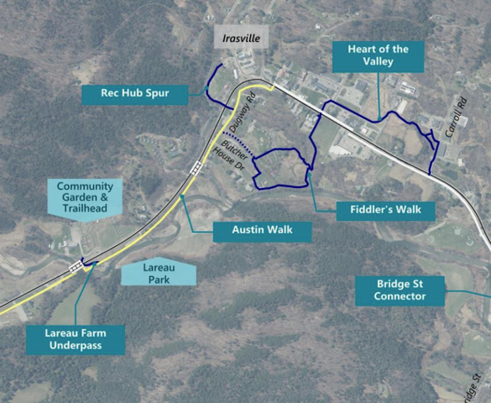




MILL BROOK CROSSING TO FIDDLERS WALK
Bike and pedestrian bridge over Mill Brook, plus
400 feet of Aggregate Shared Use Path in VT 100 ROW to Dugway Rd

Slide 11

MILL BROOK CROSSING TO FIDDLERS WALK WILL
Connect Waitsfield village and the Rec Hub to Lareau Swimming Area, Lareau Farm and Forest, and Americal Flat Bread
Improve bike and pedestrian safety
Implement segment 9 of the MRP Active Transportation Corridor
Fill in the gap in connectivity between the Austin Path and Fiddlers Walk
The Town of Waitsfield has endorsed the implementation of the scoping study, authorized the Mad River Path to seek the implementation funding on behalf of the municipality, and committed the local match for the TA application
The Town of Waitsfield has endorsed the implementation of the scoping study, authorized the Mad River Path to seek the implementation funding on behalf of the municipality, and committed the local match for the TA application

Slide 14
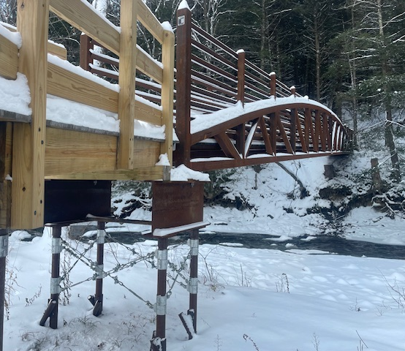
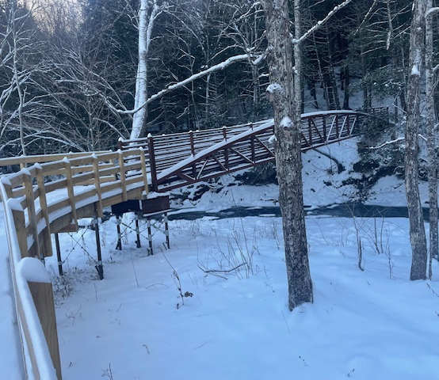
Mill Brook Bridge at the MRV Rec Hub
This bridge, installed in 2024, connects the Rec Hub with the network of multi-use trails

Slide 15
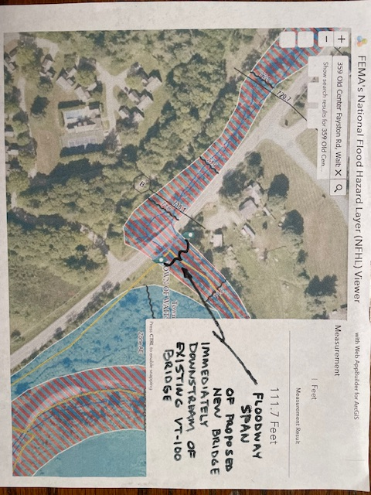

Slide 16
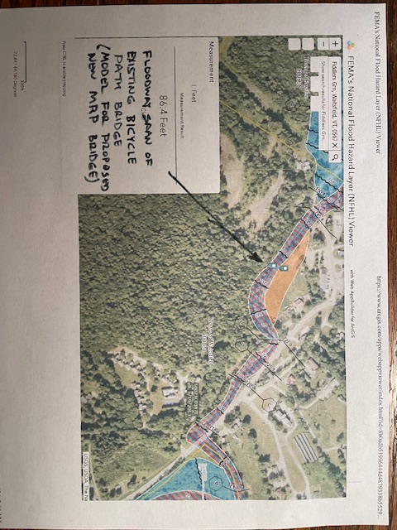

Slide 17
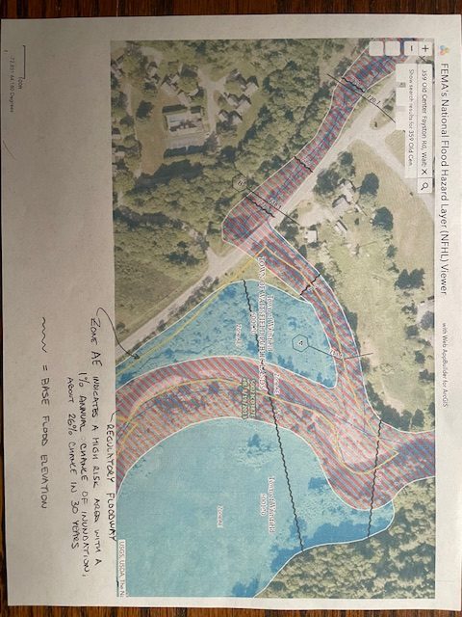

Slide 18

Waitsfield Town Plan 2023
The Waitsfield Town Plan highlights the Mad River Path as a significant element of the Town's recreational and transportation infrastructure. Recent expansions undertaken by the Mad River Path, in collaboration with local landowners, have created opportunities for a future interconnected trail network. This network aims to connect key areas such as Irasville, Warren Village, and Waitsfield Village, thereby enhancing non-motorized access and supporting the growing recreation economy.

Slide 19
Thank you!

Slide 20
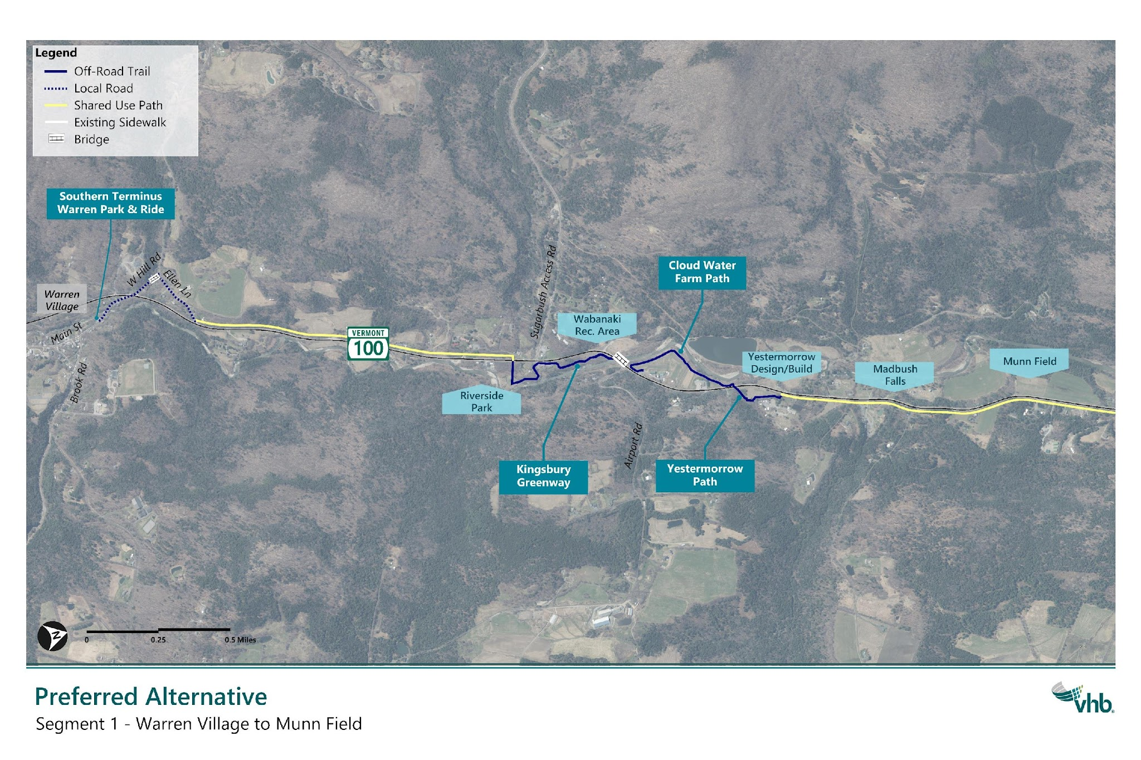
Segment 1 – Warren Village to Munn Field
Length: 1.1 miles

Slide 21
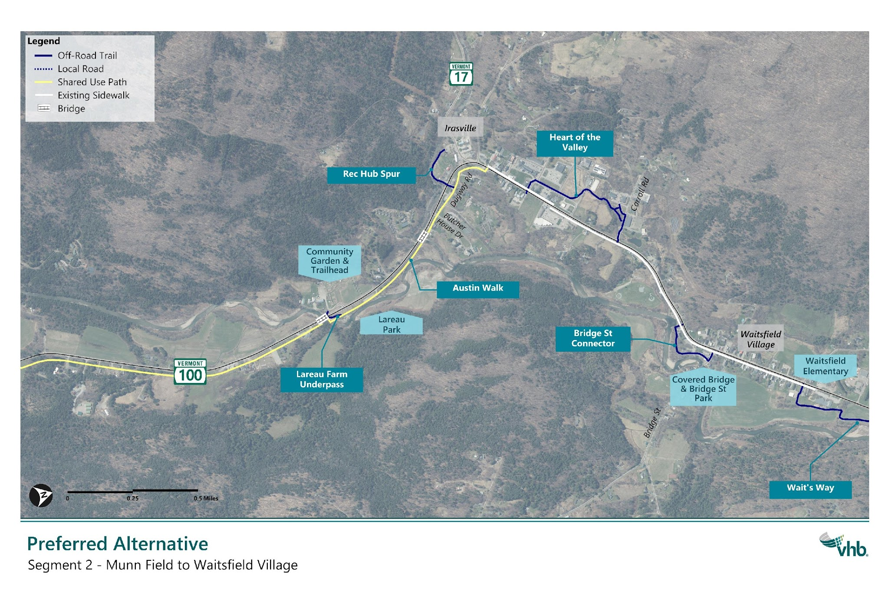
Segment 2 – Munn Field to Waitsfield Village
Length: 1.1 miles

Slide 22
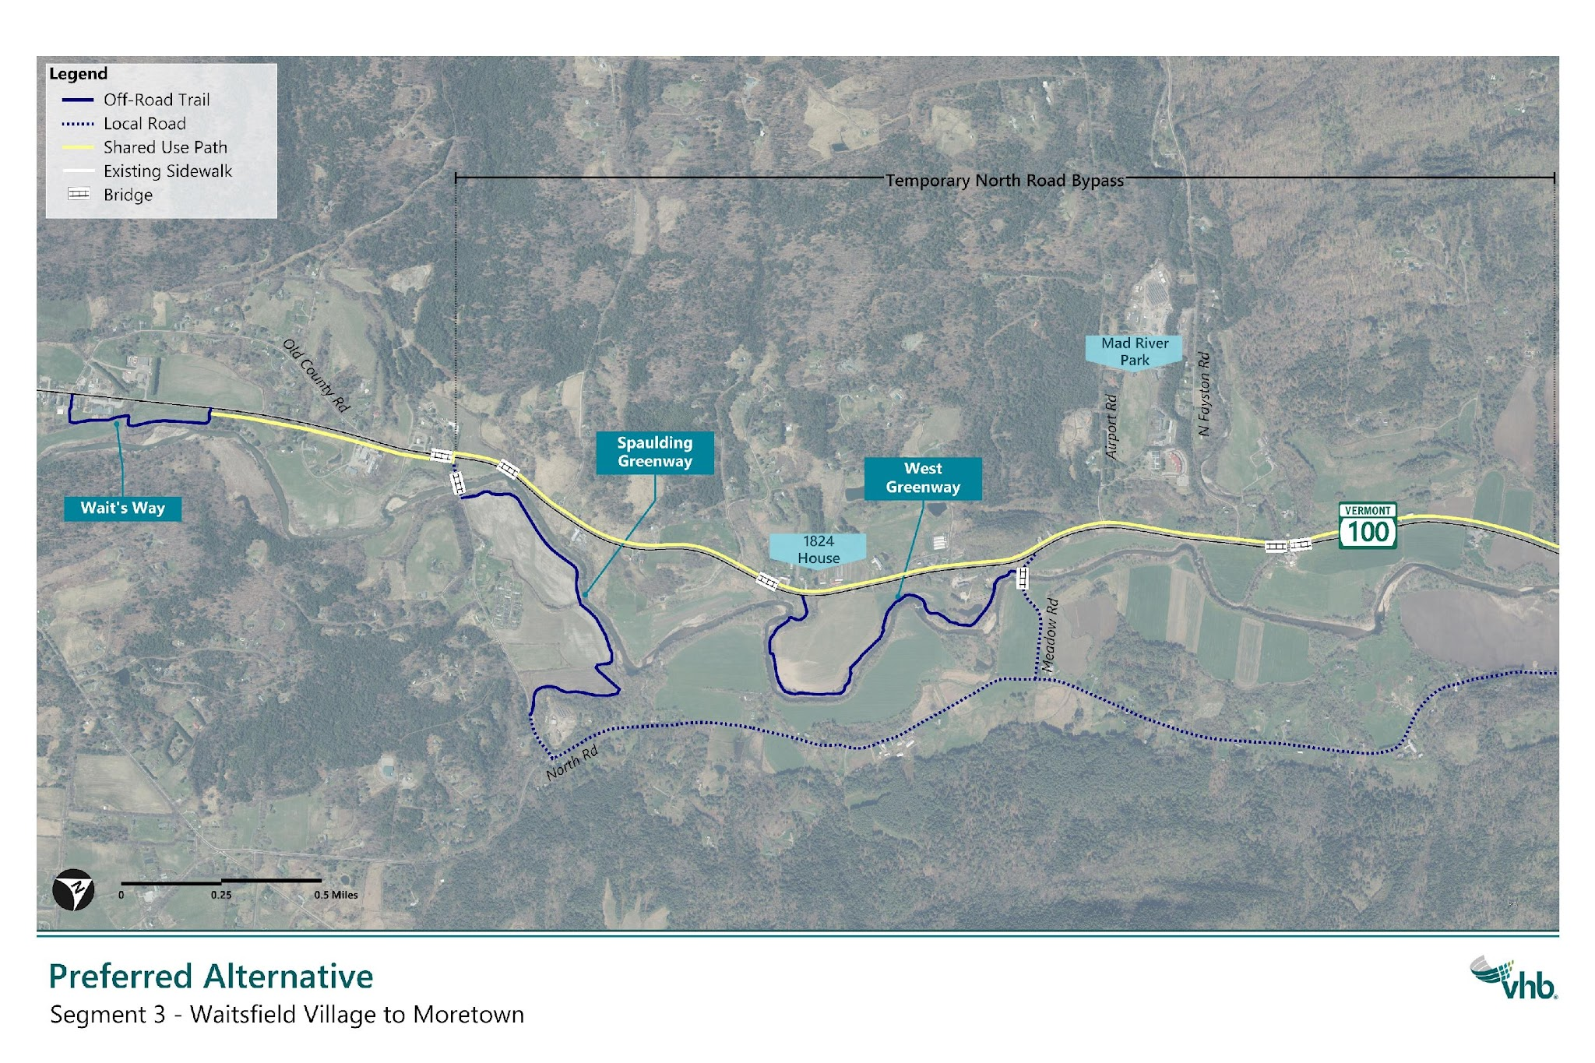
Segment 3 – Waitsfield Village to Moretown
Length: 1.1 miles

Slide 23
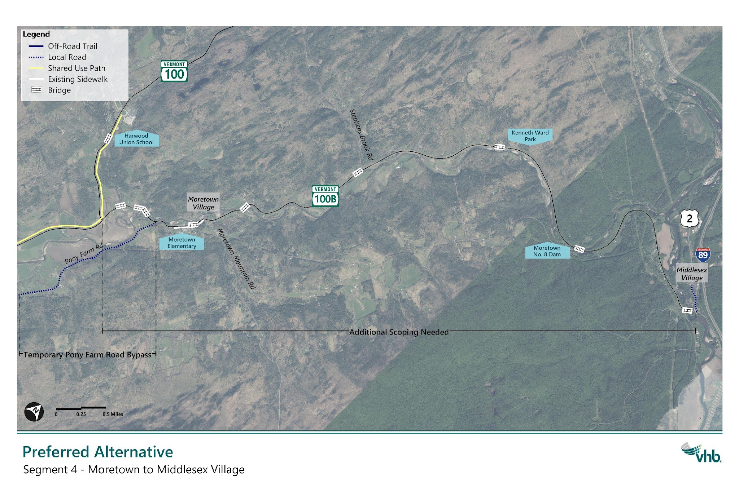
Segment 4 – Moretown to Middlesex Village
Length: 1.1 miles

